Slide 1





Instagram User Analytics
Created by Shivam Singh

Slide 2

Contents
Project Description
Approach
Tech – Stack Used
Insights
Results

Slide 3

Project Description
We are expected to submit a comprehensive report for the Marketing and Investor Metrics department as part of this project. Using a variety of measurements and insights, this analysis will assist them in reaching a choice.

Slide 4

Approach
Database creation: Used MySQL Workbench to create and put the values into the database using the DDL and DML SQL queries that the we have already supplied (as per project).
Extraction of insights: Following database creation, SQL queries are executed in MySQL Workbench to get the necessary insights from the database tables.
Tech- Stack Used
Since MySQL Community Server-GPL is a free and open-source relational database management system that employs SQL, I used MySQL Community Server-GPL Version 8.0.41 and Connector Version C++ 8.0.41 to create my project. Using the DDL and DML SQL queries that we had previously provided (as per project), MySQL Workbench was used to generate and insert the values into the database.

Slide 5

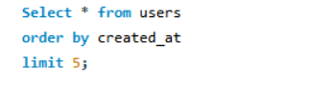
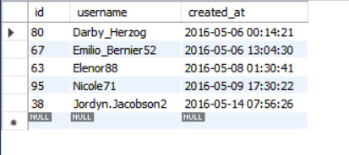
Insights: Marketing Analysis
Loyal Users Reward: People who have been using the platform for the longest time.
TOP 5 Oldest Users , using Instagram from longtime:

Slide 6
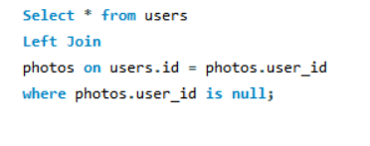
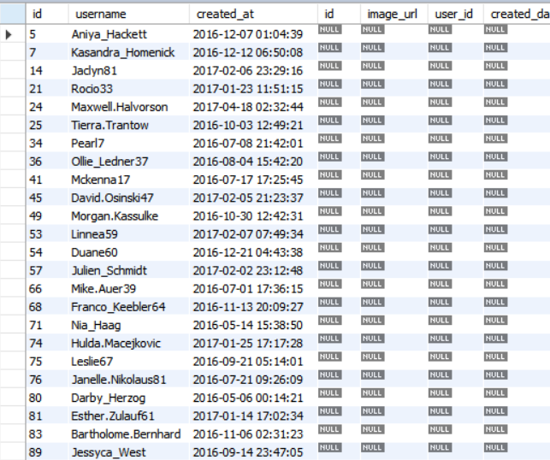
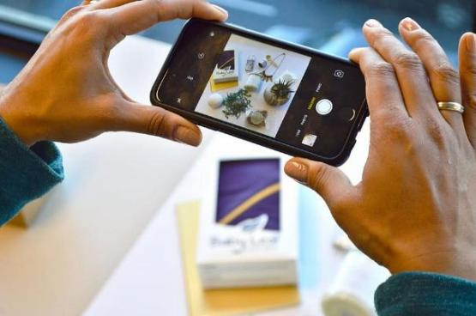
Inactive User Engagement: People who haven’t share single photos on Instagram
There are 26 people who have never posted a single photo on Instagram. They'll be receiving promotional emails to post their 1st photo.

Slide 7

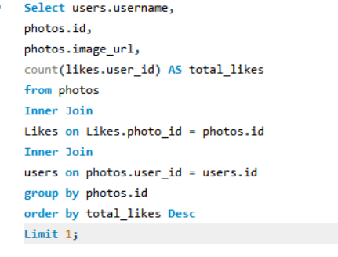

Contest Winner Declaration: Winner of the Contest
Details of the winner of the contest are:

Slide 8

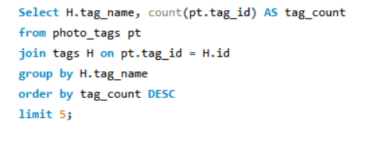

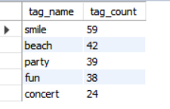
Hashtag Research: Most frequently used Hashtag
Top 5 hashtags that are most frequently used on Instagram

Slide 9
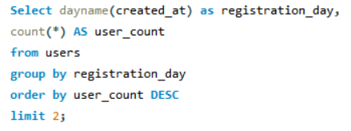



Ad Campaign Launch: Best Day to schedule Advertisement Campaign
Below are the days, users are most active on Instagram

Slide 10
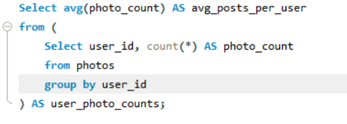

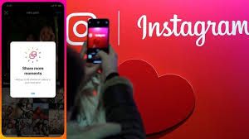


Insights: Investor Metrics
User Engagement:
Average Users who post Photos on Instagram
Total number of Photos on Instagram divided by the total number of users
100 Total users (as per the data)
257 Total posts made.
Total Photos/Total users = 257/100 = 2.57
Average Users post on Instagram are:

Slide 11
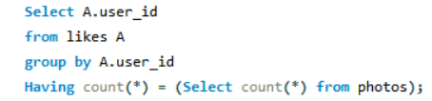
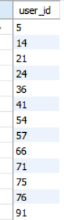

Bots and Fake Accounts: Users who have liked every single posts will be considered as Bots
There are 13 users who have liked every
posts or called as Bots:

Slide 12
Results
From this Project, I learned basic data analysis techniques utilizing SQL queries to extract insights from database by which we analyze user engagement and interaction with our digital product (software or mobile application) in an attempt to generate business insights for marketing, product & development teams.
Conclusion from the whole Analysis of the Project:
The most devoted consumers can be rewarded by the marketing team; they can also send promotional letters to inactive users, apply most popular hashtags and most active day for brand promotions.
For the business, user involvement can be really helpful as a growth success indicator.
The company can remove bots and fraudulent accounts from the site to improve the user experience.

Slide 13


